Slide 1
졸업 프로젝트 진행상황 Wavelet & FPN
담당 교수님: 김은이 교수님
팀원: 유종우(201410239)
김재원(201711296)
이서영(201711327)

Slide 2
Feature Pyramid Network - 1
현재 진행
D_num = 1로 유지, Upsampling Layer ++
Dicriminator_ Num : 3 -> 1
Upsampling Layer : 4
Upsampling Factor : 4 -> 2
Total Layer : 7 X 3 -> 10 X 1
Upsampling Layer = 4 로 유지, D_num -> 3
Epoch 140까지 진행(19 Hour)
5.6 epoch / hour
7.5 epoch / hour
Notes:
[16, 1, 8192] -> [16, 16, 4096]
-> [16, 32, 2048]
-> [16, 64, 1024]
-> [16, 128, 512]
-> [16, 256, 256]
- bottom_up -
-> [16, 256, 256] ->(upsampling) [16, 256, 512] + (lateral layer)[16, 256, 512]
-> [16, 256, 512] ->(upsampling) [16, 256, 1024] + (lateral layer)[16, 256, 1024]
-> [16, 256, 1024] ->(upsampling) [16, 256, 2048] + (lateral layer)[16, 256, 2048]
-> [16, 256, 2048] ->(upsampling) [16, 256, 4096] + (lateral layer)[16, 256, 4096]
-> [16, 256, 4096] ->(upsampling) [16, 256, 8192] + (lateral layer)[16, 256, 8192] ->[16, 1, 8192] => 최종 답

Slide 3

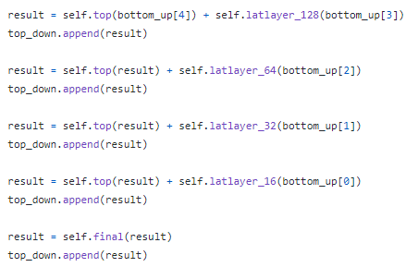
Feature Pyramid Network - 1
Lateral Layer
Top Down
Notes:
[16, 1, 8192] -> [16, 16, 4096]
-> [16, 32, 2048]
-> [16, 64, 1024]
-> [16, 128, 512]
-> [16, 256, 256]
- bottom_up -
-> [16, 256, 256] ->(upsampling) [16, 256, 512] + (lateral layer)[16, 256, 512]
-> [16, 256, 512] ->(upsampling) [16, 256, 1024] + (lateral layer)[16, 256, 1024]
-> [16, 256, 1024] ->(upsampling) [16, 256, 2048] + (lateral layer)[16, 256, 2048]
-> [16, 256, 2048] ->(upsampling) [16, 256, 4096] + (lateral layer)[16, 256, 4096]
-> [16, 256, 4096] ->(upsampling) [16, 256, 8192] + (lateral layer)[16, 256, 8192] ->[16, 1, 8192] => 최종 답

Slide 4
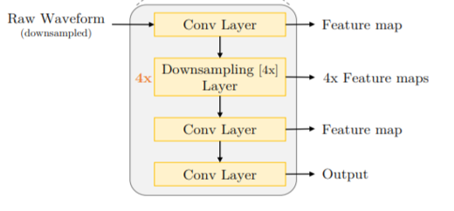
Feature Pyramid Network - 1
기존 방식
Feature Pyramid
Upsampling
Conv Layer
1 x 1
+
3 x 3
predict
1 x 1
Upsampling
Conv Layer
+
3 x 3
predict
1 x 1
Upsampling
4x
Downsampling
+
3 x 3
predict
4x
1 x 1
Upsampling
Conv Layer
+
3 x 3
predict
Bottom-up
Top-down
결과 :–너무 많은 연산으로 인해서 Batch Size를 16 -> 1 로 줄여서 진행 시간이 너무 오래 걸리고 제대로 된 결과가 나오지 않음.

Slide 5
Feature Pyramid Network - 1
TOP
Bottom-up
Upsampling
Top-down
[16, 256, 512]
1 x 1
[16, 256, 1024]
Upsampling
Conv Layer
1 x 1
+
3 x 3
predict
[16, 128, 1024]
+
Upsampling
1 x 1
Upsampling
1 x 1
3 x 3
[16, 64, 2048]
[16, 256, 2048]
+
Conv Layer
+
predict
1 x 1
Upsampling
[16, 256, 4096]
Upsampling
3 x 3
[16, 32, 4096]
1 x 1
+
4x
Downsampling
+
predict
Upsampling
1 x 1
Upsampling
1 x 1
3 x 3
[16, 16, 8192]
[16, 256, 8192]
+
Conv Layer
+
predict
Bottom-up
Top-down
Input : [16, 1, 8192]
[16, 1, 8192]
Notes:
[16, 1, 8192] -> [16, 16, 4096]
-> [16, 32, 2048]
-> [16, 64, 1024]
-> [16, 128, 512]
-> [16, 256, 256]
- bottom_up -
-> [16, 256, 256] ->(upsampling) [16, 256, 512] + (lateral layer)[16, 256, 512]
-> [16, 256, 512] ->(upsampling) [16, 256, 1024] + (lateral layer)[16, 256, 1024]
-> [16, 256, 1024] ->(upsampling) [16, 256, 2048] + (lateral layer)[16, 256, 2048]
-> [16, 256, 2048] ->(upsampling) [16, 256, 4096] + (lateral layer)[16, 256, 4096]
-> [16, 256, 4096] ->(upsampling) [16, 256, 8192] + (lateral layer)[16, 256, 8192] ->[16, 1, 8192] => 최종 답

